Slide 1

XAI for Forest Fire Risk Assessment
Visualizing Meteorological Drivers with SHAP Frameworks
University of Trieste | Data Visualization June 9th, 2026

Slide 2


01. RESEARCH CONTEXT
Dataset Summary
Origin: Montesinho Natural Park (Portugal).
Telemetry: Real-time weather data (Temp, RH, Wind, Rain).
Objective: Predict burned area using Random Forest Regressors.
Source: Cortez & Morais (2007) | UCI Machine Learning Repository

Slide 3

01. RESEARCH CONTEXT
Dataset Summary
Origin: Montesinho Natural Park (Portugal).
Telemetry: Real-time weather data (Temp, RH, Wind, Rain).
Objective: Predict burned area using Random Forest Regressors.
Analytical Challenge
Machine Learning models are typically "black-boxes."
By applying SHAP (SHapley Additive exPlanations), we map mathematical weights into intuitive Visual Channels for human interpretation.
Source: Cortez & Morais (2007) | UCI Machine Learning Repository

Slide 4





01.1 DATASET AT A GLANCE
Variable Overview (13 total)
Key Statistics
Variable | Type | Description
X, Y | Spatial | Coordinates in Montesinho Park
month, day | Temporal | Date of the observation
FFMC, DMC, DC, ISI | FWI Indices | Derived fire risk indices (not used)
temp, RH, wind, rain | Meteorological | Used in model (directly observable)
area | Target (ha) | Burned area to predict
517
47.8%
total records
fires with area > 0 ha
69%
1,091 ha
records in Aug-Sep
largest fire recorded
Focus: 4 meteorological variables only, isolating direct atmospheric conditions from derived FWI indices.
Meteorological Ranges
Temp: 2.2 - 33.3 °C (mean 18.9°C)
RH: 15 - 100 % (mean 44.3%)
Wind: 0.4 - 9.4 km/h (mean 4.0)
Rain: 509 / 517 records have zero rain (98.5%)
Source: Cortez & Morais (2007) | UCI Machine Learning Repository
Rain: 509 / 517 records have zero rain (98.5%)

Slide 5

02. ADDRESSED QUESTIONS
1. How do individual meteorological factors globally impact the prediction of fire risk?

Slide 6
02. ADDRESSED QUESTIONS
1. How do individual meteorological factors globally impact the prediction of fire risk?
2. What specific weather triggers drove the prediction for a high-risk case study (Day 5)?

Slide 7

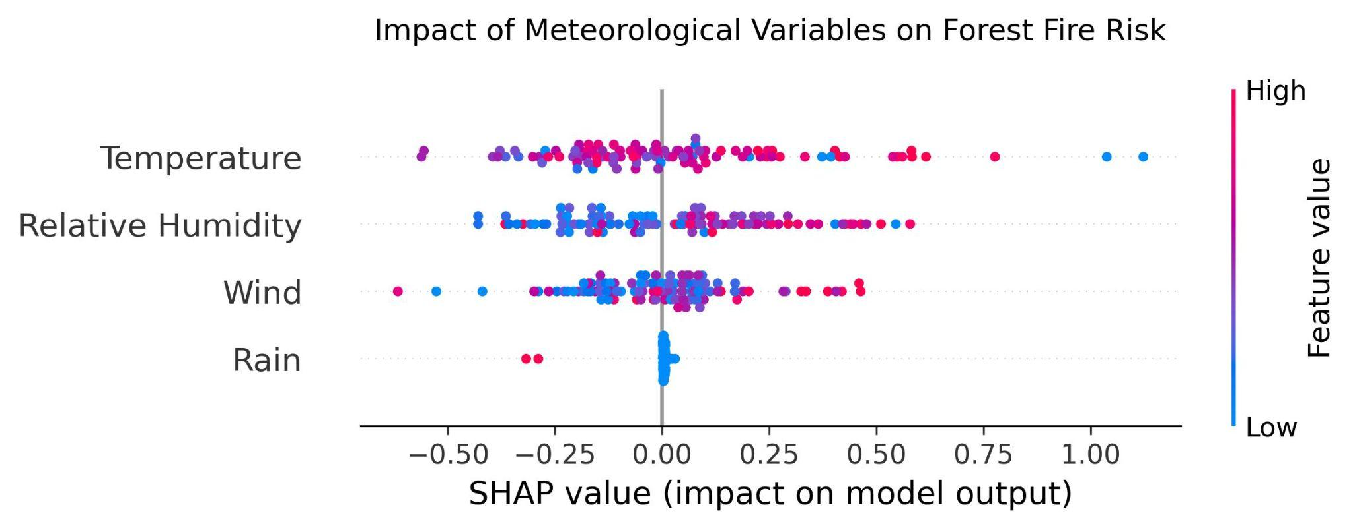
03. GLOBAL IMPACT ANALYSIS
The model captures counterintuitive relationships: higher temperatures unexpectedly lower predicted risk, exposing complex variable interactions.

Slide 8
03. MAPPING: GLOBAL VISUALIZATION
Data Attribute | Attribute Type | Visual Channel Assigned
Feature Importance | Nominal / Ranked | Vertical Position (Y-axis Order)
Impact on Prediction | Quantitative | Horizontal Position (X-axis)
Predictor Value | Quantitative | Color (Diverging Blue-to-Red)
Sample Density | Quantitative | Vertical Jitter (Point Clusters)
Note the non-linear interactions: even at low temperatures (blue dots), extreme wind or drought conditions can push risk to the right.

Slide 9
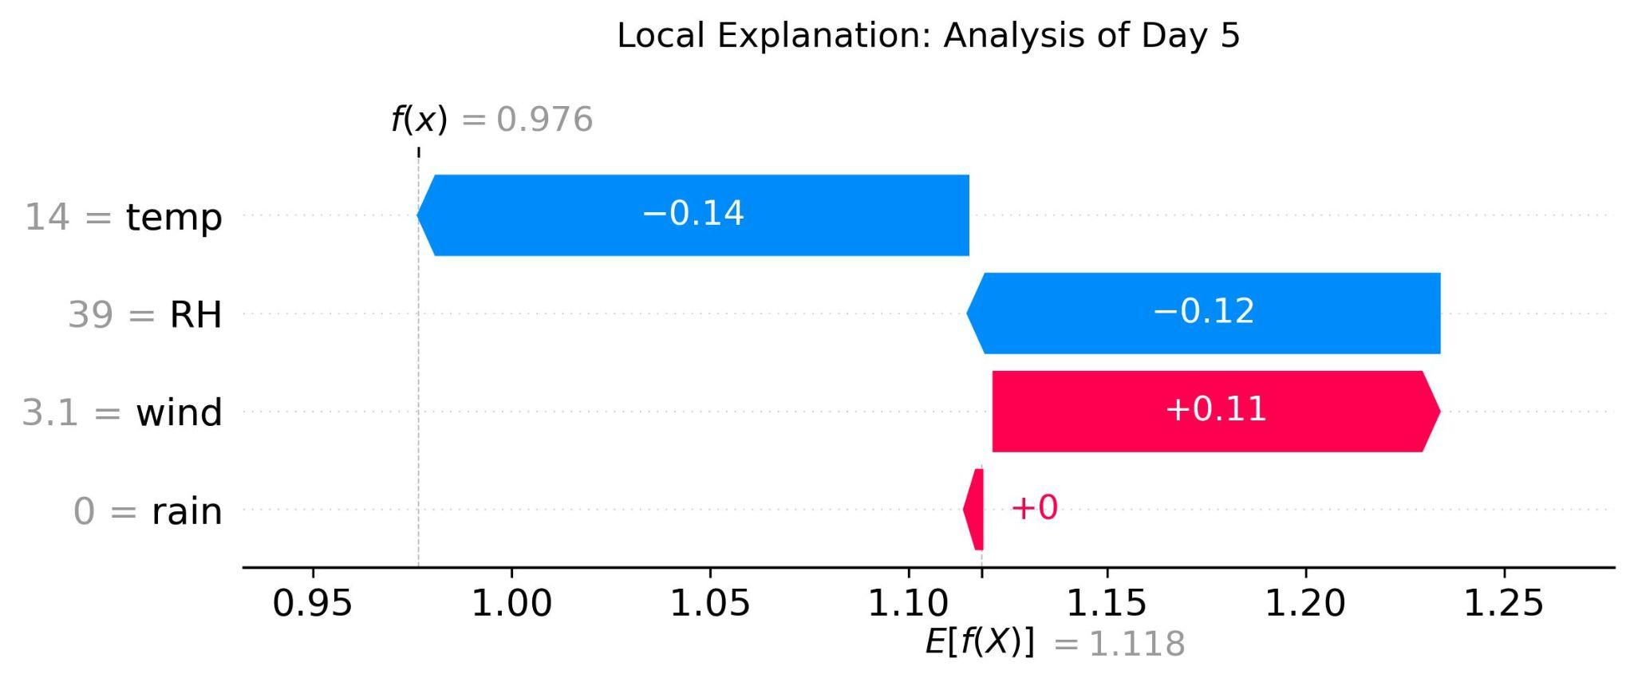
04. LOCAL EVENT BREAKDOWN
On Day 5, the cooling effects of temperature (14) and humidity (39) outweighed wind impact (+0.11), dropping the final risk prediction to 0.976.

Slide 10
04. MAPPING: LOCAL VISUALIZATION
Data Attribute | Attribute Type | Visual Channel Assigned
Expected Baseline | Quantitative | X-Axis Origin Point
Feature Contribution | Quantitative | Bar Horizontal Width (Size)
Impact Direction | Categorical | Color (Pink: Increase / Blue: Decrease)
Final Output Area | Quantitative | Final X-Axis Endpoint
This sequential decomposition (Waterfall) minimizes cognitive load while identifying specific environmental triggers for a single prediction.

Slide 11




05. INDIVIDUAL CONTRIBUTIONS
Student Contributions
Bonus: Discarded Visualization
Arahí Fernández Monagas
Discarded: SHAP Bar Chart (mean |SHAP|)
-
Dataset selection and exploration
A simple bar chart ranking features by average absolute SHAP value was considered as an alternative global explanation.
-
Random Forest model training and evaluation
-
SHAP explainability framework (global + local)
Why rejected: collapses distribution to a single mean, losing direction of impact and non-linear behavior. The beeswarm encodes more information per visual channel with no added cognitive load.
-
SHAP Beeswarm and Waterfall visualizations
-
Presentation design and narrative
Beeswarm advantage: shows magnitude, direction AND feature value (color) simultaneously for all samples, revealing non-linear interactions that bar charts hide.
Source: Cortez & Morais (2007) | UCI Machine Learning Repository

Slide 12
Conclusion
Black-box models can inherit historical data biases, learning false physical relationships. XAI visualizations act as a critical audit tool, exposing these flaws to prevent blind trust in automated systems
University of Trieste | Data Visualization 2026 Summer Session

